Slide 1


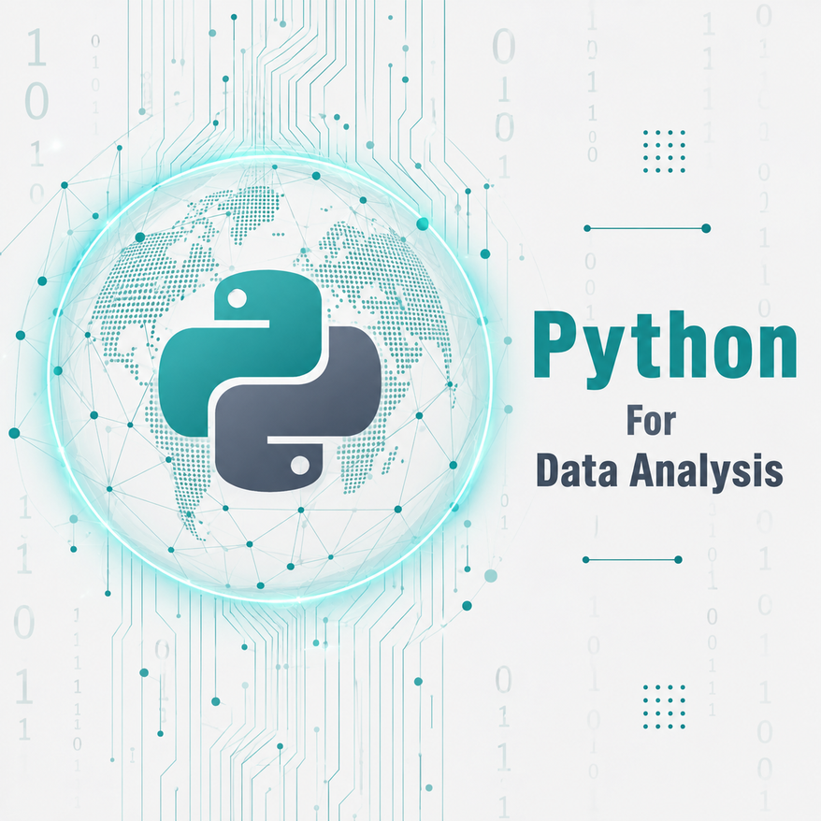




DATA ANALYSIS
Module 5: Python For Data Analysis
Python Fundamentals, Consolidated
Topic 1 of 4

Slide 2




MODULE 5 OBJECTIVES
Understand and use core Python data structures: variables, data types lists, and dictionaries to represent and organize data
Apply Python control flow: use if statements and for loop to apply rules and process multiple records efficiently.
Create reusable Python code: import libraries and write functions to perform calculations and repeat common analysis tasks.
Read, debug, and verify Python code: interpret common Python errors, fix problems, rerun code, and verify results against expected values.
Notes:
1.7.2013
‹#›

Slide 3


Learning outcome
By the end of this topic, the trainee can…
1- Understand and apply core Python data structures: Use variables, data types, lists, and Understand and apply core Python data structures: Use variables, data types, lists, and
2- Implement Python control flow: Use if statements and for loops to apply rules and process multiple records efficiently.
3- Develop reusable Python code: Import libraries and write functions to perform calculations and repeat common analysis tasks.
Notes:
1.7.2013
‹#›

Slide 4
Why Python Matters for Data Analysts
The scenario: a Lagos retail chain logs around 40,000 transactions a month across twelve branches. Excel opens the file slowly, and the finance team repeats the same cleaning steps by hand, every month, on every branch file.
Handles data too large or too messy for a spreadsheet to open comfortably
reused every month
# one script, run monthly
clean_transactions(march_file)
clean_transactions(april_file)
clean_transactions(may_file)
Repeats a cleaning or analysis routine exactly the same way, every time, with no copy-paste drift
Connects directly to databases, APIs and the AI tools you already use
The same script that cleans forty thousand rows also cleans four million
The result: the same reliability whether the file has forty rows or forty thousand.
Excel: manual, click by click. Python: written once, run forever.
Notes:
1.7.2013
‹#›

Slide 5
Python as a Tool for Scalable Analysis
EXCEL
PYTHON
About 1,048,576 rows per sheet, and performance drops well before that
No practical row limit for analyst-scale data
Every formula is rebuilt or dragged down by hand
Code documents every step, in order, in plain text
Recalculates on open; easy to change a cell by accident
Rerun the exact same script on a new file in seconds
Hard to prove the same steps ran twice, the same way
One script works on one hundred rows or ten million
This is exactly why next session introduces pandas, the library built to load and work with tables like these.

Slide 6
Recap: Variables and Data Types
str — text labels, e.g. "Lagos"
branch_name = "Lagos"
total_sales = 245000
average_sale = 15312.50
target_met = True
int / float — numbers you calculate with
bool — a True or False check
Excel parallel: a Python variable is a named cell. total_sales = 245000 stores a value the way typing 245000 into a cell does, except the name can be reused anywhere in your code.
Why an analyst uses it: store a calculated result once, then reuse it in every later step without retyping or recalculating it.
Retrieval check: from Python Zero, what data type would target_met become if you wrote "True" in quotes instead?

Slide 7
Lists and Dictionaries in Data-Analysis Contexts
LIST — a collection of values
DICTIONARY — one structured record
daily_sales = [
15000, 9500,
21000, 18000
]
transaction = {
"branch": "Lagos",
"amount": "15,000",
"date": "2026-03-01"
}
One branch's sales across four days.
One record, with named fields, the way one spreadsheet row has named columns.
OUTPUT
print(transaction["branch"])
Lagos
Why an analyst uses it: a list of dictionaries is exactly what a small dataset looks like before you load it into pandas next session.

Slide 8
Conditions and Loops: Applying Rules at Scale
if applies a business rule to one value
target = 12000
for sale in daily_sales:
if sale >= target:
print(sale, "Above target")
else:
print(sale, "Below target")
for repeats that check across an entire list
Together, they flag every record against a threshold in a single pass
Why an analyst uses it: flag every record against a target, threshold or category across a whole dataset, not just the row in front of you.
OUTPUT
15000 Above target
9500 Below target
21000 Above target
18000 Above target
Retrieval check: from Week 4, what would a GROUP BY and this loop have in common?
Excel parallel: if is IF(); looping is filling a formula down every row.

Slide 9
Importing Libraries: Standing on Tested Code
A library is code someone else already wrote, tested and maintained
import statistics
statistics.mean(daily_sales)
import brings it into your notebook, ready to use
Analysts rarely calculate statistics by hand; they import a trusted library instead
OUTPUT
15875.0
Coming next: you will import pandas, the library built specifically for tables of data.
Excel parallel: importing a library is like turning on an add-in, the tools appear, but you still decide how to use them.

Slide 10
Calling Functions: Reusing a Calculation
A function packages a calculation so you can reuse it without retyping it
def average_sale(sales_list):
return statistics.mean(sales_list)
average_sale(daily_sales)
Call it once per branch, once per month, on any list you give it
def names the function; return sends the result back
OUTPUT
15875.0
Excel parallel: the same idea as naming a formula once, then referencing that name everywhere instead of rebuilding it in every cell.
This clean, well-behaved function is about to meet real, messy data. That is next.

Slide 11
Reading Python Error Messages
NameError
A variable or function name was never defined. Check the spelling.
TypeError
Two incompatible types were mixed, e.g. text and a number.
ValueError
The right type, but a value Python cannot use, e.g. text with a currency symbol passed to float().
KeyError
The dictionary does not contain the key you asked for.
IndexError
You asked for a list position that does not exist.
Read the last line of the traceback first, it names the problem. Then look upward to find the line that caused it. An error is Python telling you exactly what went wrong, not a verdict on you.

Slide 12
Debug It: Before and After
BEFORE — the broken cell
AFTER — the fix
def clean_amount(value):
return float(value)
clean_amount("₦15,000")
def clean_amount(value):
value = value.replace("₦", "")
value = value.replace(",", "")
return float(value)
clean_amount("₦15,000")
ValueError: could not convert string to float: '₦15,000'
Means: float() needs digits only. The ₦ symbol and comma are not valid parts of a number.
Locate it: the input still carries currency formatting from the source file.
OUTPUT
15000.0
Verify: ₦15,000 in the source file now matches 15000.0 in the notebook.
Do not panic at an error. Read it, locate the line, fix one thing, rerun, and verify against a known value.

Slide 13
Your Turn: Fix and Extend
Extend clean_amount so it also removes "NGN "
transactions = [
{"branch": "Abuja", "amount": "NGN 9,500"},
{"branch": "Kano", "amount": "NGN 21,000"},
]
Write a loop that prints each branch with its cleaned amount
Time-box: 10 minutes, in pairs. Explain your fix to your partner before you run it.
OUTPUT
Abuja: 9500.0
Kano: 21000.0
A worked solution file is on publica.academy. Try it yourself first, then compare and verify.

Slide 14
Python Analyst Readiness Check
Answer from memory before opening your notebook.
1
Which data type would you use to store one full transaction record with named fields?
2
What is the practical difference between a list and a dictionary?
3
Which Python error appears when you try to convert "₦2,000" directly into a number?
4
Where should you look first in an error message to find out what went wrong?
5
Why would an analyst write a function instead of repeating the same code for every branch?

Slide 15

Key Takeaways
Use Python data structures to organize data.
Apply control flow and loops to process data.
Up Next: Loading and
Write reusable code with functions and libraries.
Inspecting Data with
Pandas
Debug and verify code for accurate results.
Notes:
1.7.2013
‹#›

Slide 16


Key Takeaways
Variables name and save your data.
const is the standard choice.
Up Next: Data Types
let is for specific updates.
Never use var.
Notes:
1.7.2013
‹#›

